Slide 1
Revision for excretion and circulatory systems test

Slide 2
Extended Response Question
It’s lunchtime and you go out to have lunch in the shade of a tree on the lawn with some friends. You open your lunch box and find the ham and cheese sandwich you made at home last night.
Using dot points: trace the digestive journey of a carbon atom in the bread of your sandwich from when you take a bite, through the alimentary canal, to being absorbed into the blood stream, used for energy in a muscle cell and being excreted via the lungs

Slide 3
The carbon atom is part of a starch molecule – in bread, eventually it will be part of a glucose molecule
Path it follows – roughly -
Mouth – chemical; mechanical; saliva
Oesophagus – peristalsis
Sphincter to stomach
Stomach – muscular walls - churning; protein digestion; acidic (muscular walls and churning)
Pyloric Sphincter – release chime into small intestine
Duodenum
Small intestine – villi, intestinal juices – enzymes from pancreas; bile from liver – emulsify fats/lipids
Absorb nutrients into villi, then to blood capillaries around the lacteal
Lacteal absorbs products of lipid breakdown
Carbon atom enters the blood stream as part of a glucose molecule
Cellular respiration – glucose + oxygen = H₂O + CO₂ C atom ends up in carbon dioxide
Carried in blood as CO_{2,} and it’s forms – carbaminohaemoglobin; in bicarbonate ions
Gas exchange at alveoli surface via diffusion – concentration of CO₂ in alveoli is low concentration compared to blood ~ high, hence CO₂ moves from capillaries to alveoli and then is exhaled from the lungs - describe exhalation …(max of 2 marks)
TOTAL = 12 of the points listed above.

Slide 4
Name and number each type of teeth
How does physical digestion and chemical digestion differ
Name the parts and functions of the alimentary canal
Draw a diagram of a villus, describe its function and what makes it physical attributes suitable for its function

Slide 5
Describe each organ involved in excretion and describe what it does
Kidneys
Lungs
Sweat glands
Alimentary canal
Liver
Bladder

Slide 6
Describe the following terms
Peristalsis
Enzymes
Vitamins
Elimination
Excretion

Slide 7
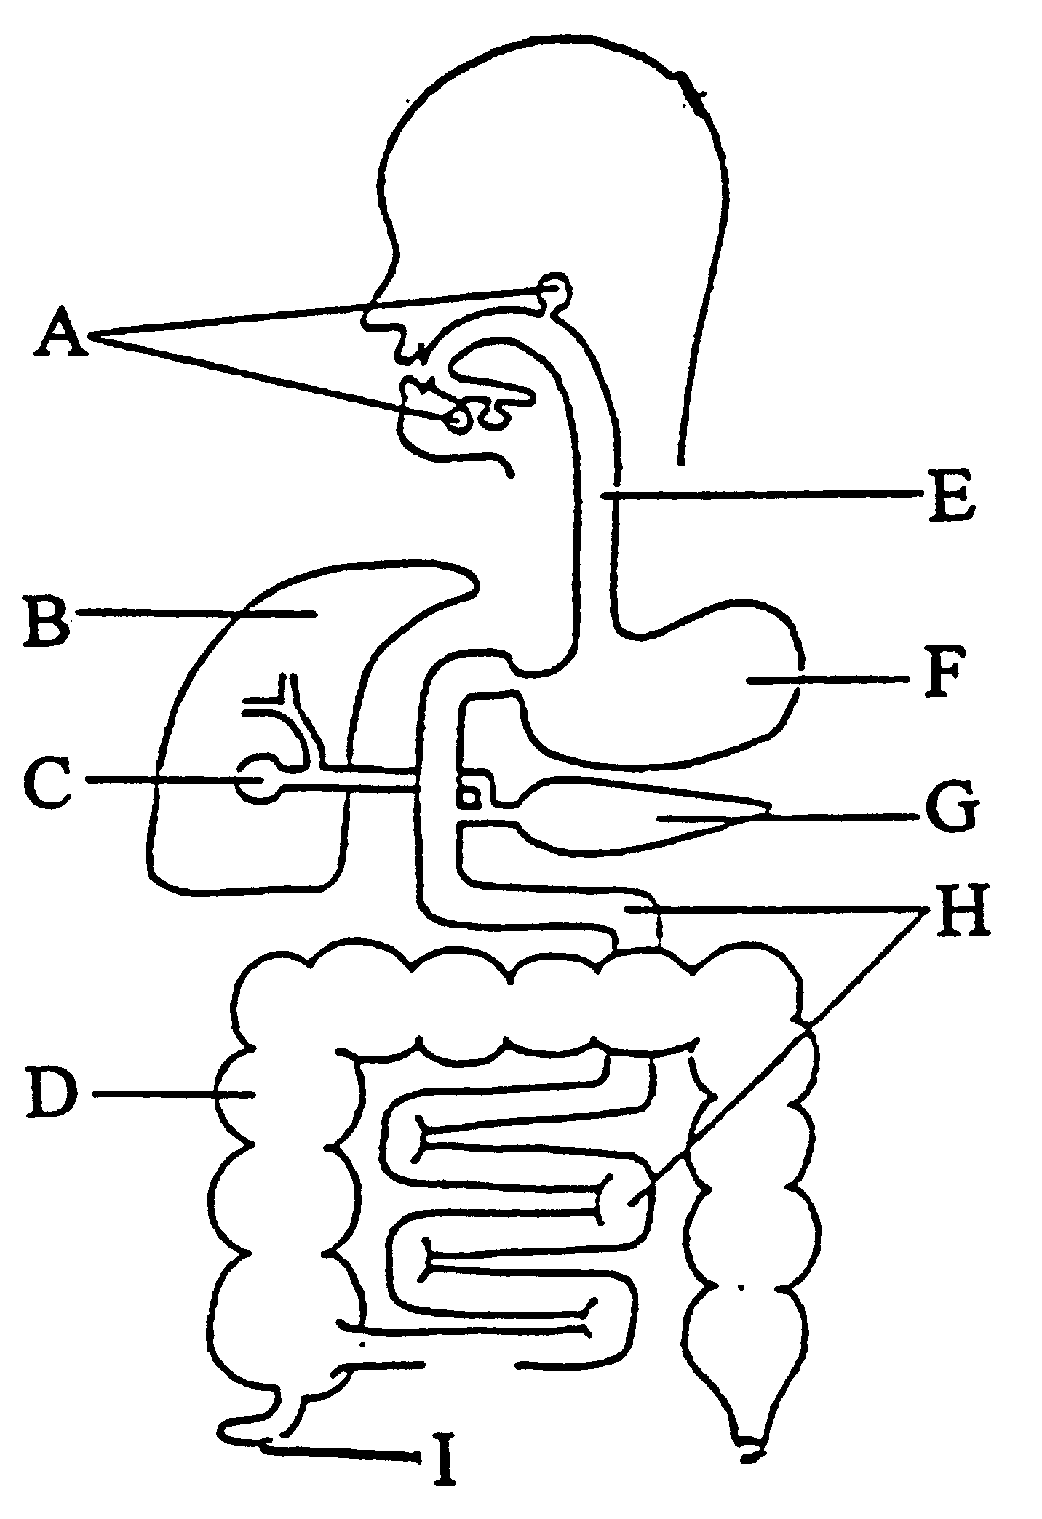
Label the digestive system and describe their functions

Slide 8
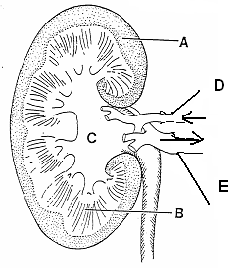
Label a kidney

Slide 9
How and where in the digestive system is a
protein digested
Fat digested
Starch

